Slide 1
Design Challenge

Slide 2
Design Challenge
My Submission regarding the Design challenge. Some of usability Observation.
Usability Issues:
Current design is not support all form factors.
Form information is very lengthy in single page view.
No clear space is define for Error message handing
In date of birth filed composite control should be used for input
Mandatory field message is missing and indictor is not marked for each filed
Background image should be removed.

Slide 3
Design Challenge
My Solution
My design approach is to make the form responsive, to use in all form factors.
In mobile view all field will be cascade view one after other.
To break the cognitive load, all three sections are showed in multistep wizard.
Indicator shows the form status with complete, in progress and not stared.
Previous and Next control, for navigate with in pages
Field level error handing on exit.
Error are shown by outline the field in red with tooltip message
message on top " All fields are mandatory".

Slide 4
Design Challenge
Deliverables
1) Desktop view of 3 screen - Basic Information, Health History & Current Habit
2) Error Handing Page screen
3) Mobile View of Basic Information

Slide 5
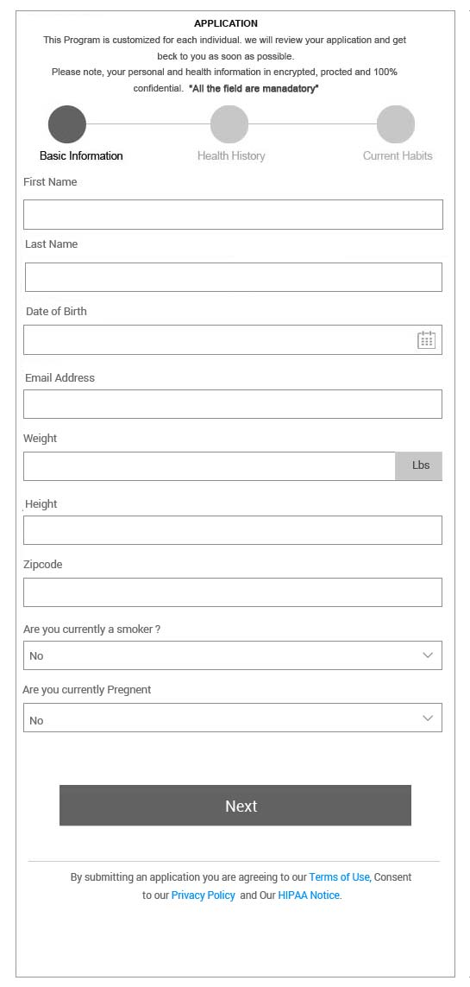
Design Mobile View

Slide 6
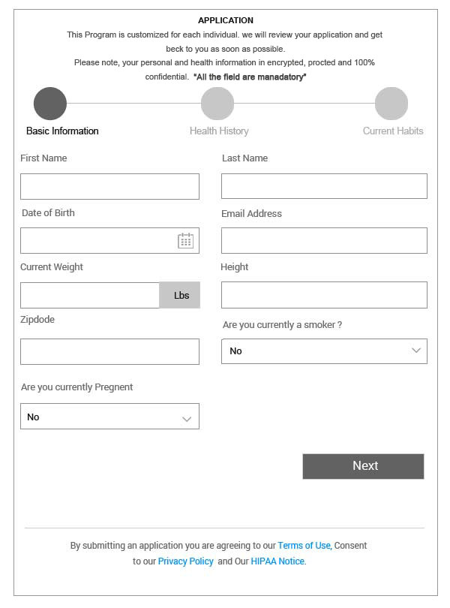
Basic Information Page View

Slide 7
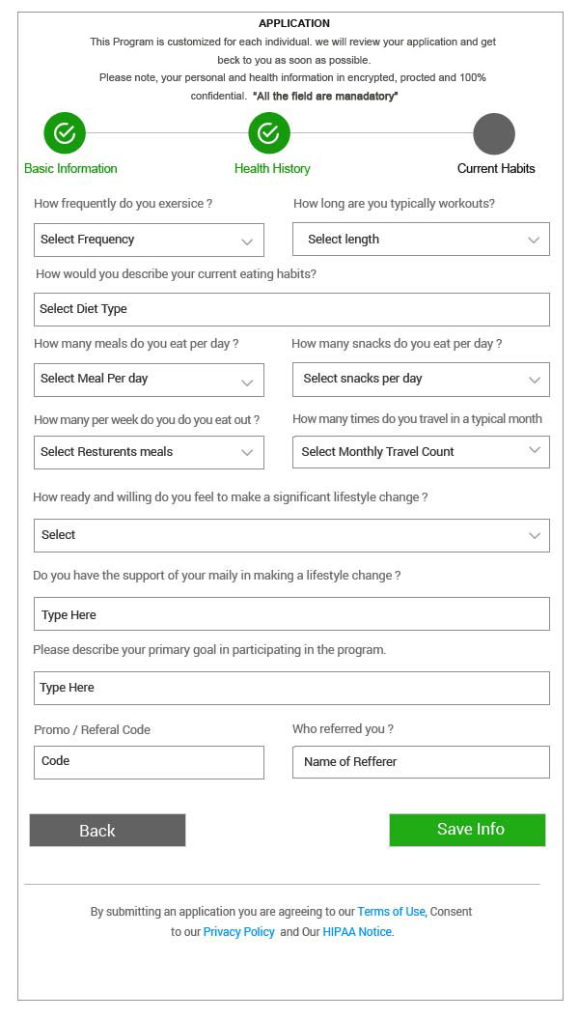
Health History Page View

Slide 8
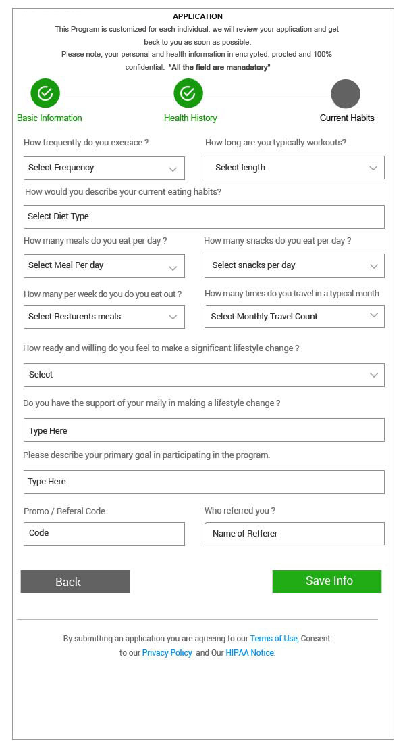
Current Habit Page View

Slide 9
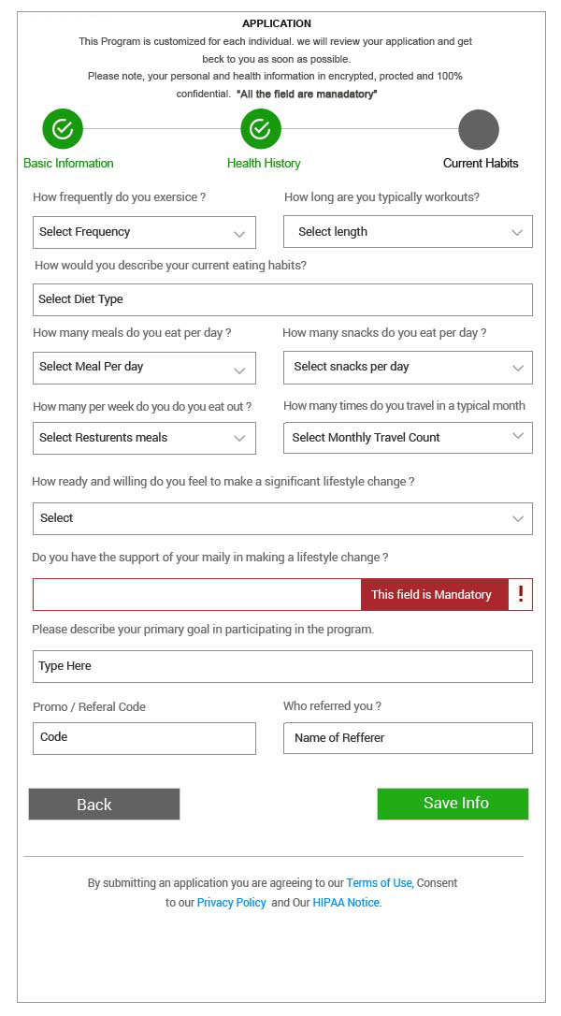
Current Habit Error Page View

